Slide 1
Women’s Security
Salutis
Team – Three Duckies
Rachit Vinay Kumar Yash Mathur

Slide 2


Problem Statement
Women’s are afraid to travel solo or at nights.
Most of the mishappening occurs at night.
Main Aim:
To create something, so that we can reduce the crimes on women up to some extent and any woman can go anywhere without any fear.

Slide 3

Solution
App that supports women while traveling on long routes, at night etc.
Detect Scream and Shout sounds
If detects then Automatically turns on the live tracking system.

Slide 4
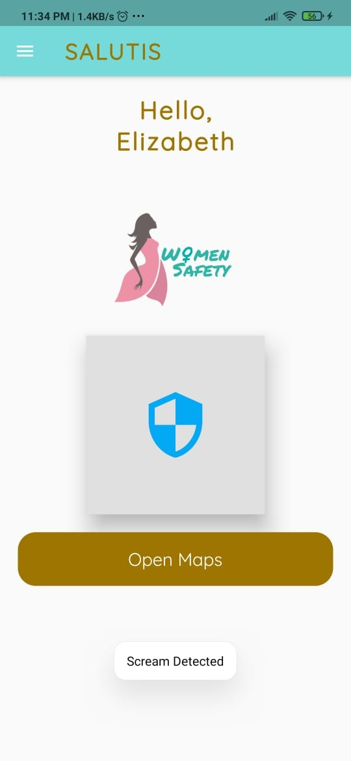
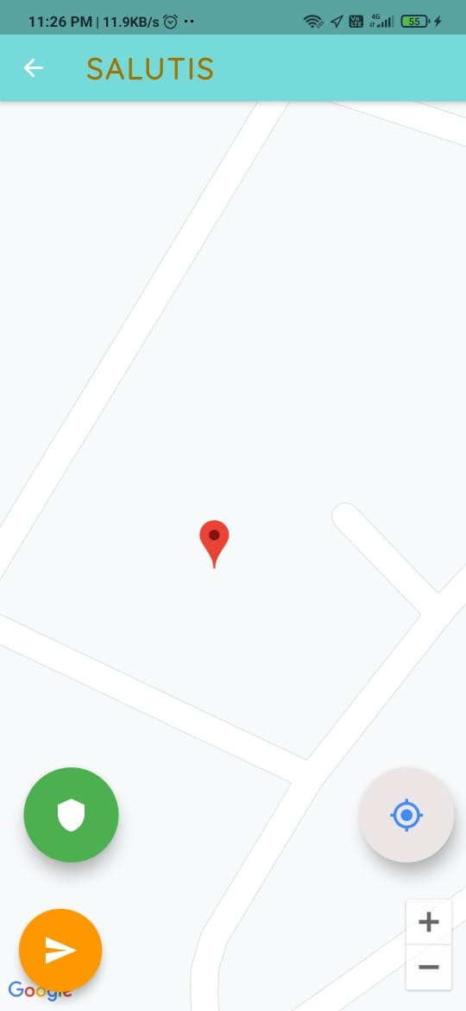
Implementation
Tech Stack :-
Flutter
TensorFlow lite
Firebase
Google Maps API
Working :-
While travelling, if you don’t feel safe turn on the feature in the app
If he detects scream, automatically live tracking will start
For police help
For relative help

Slide 5
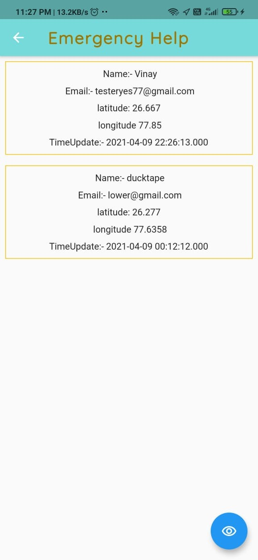
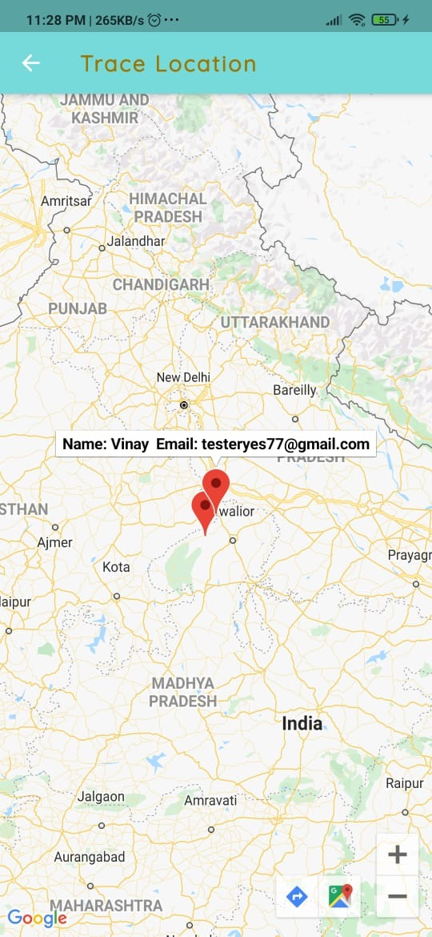
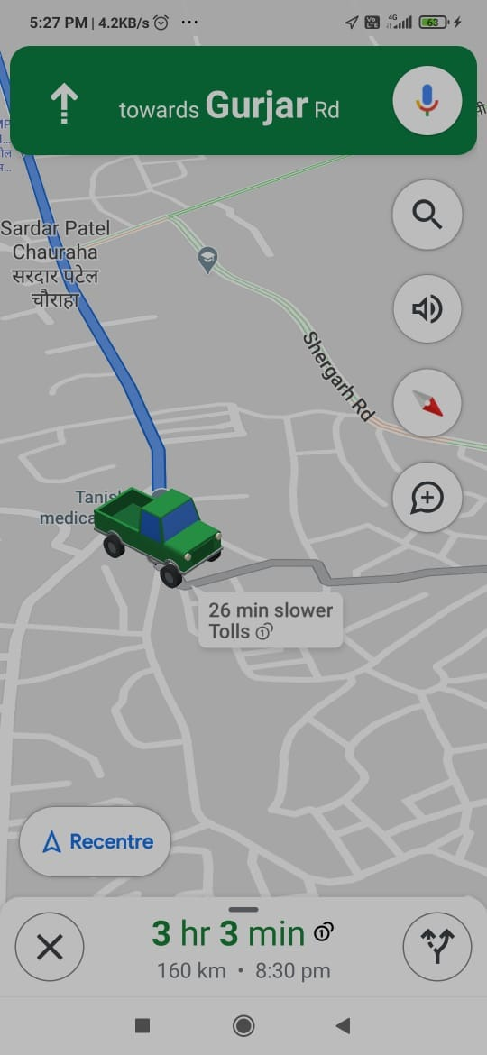
3. Details and Location of every victim
4. Shortest route to send help to the victim

Slide 6
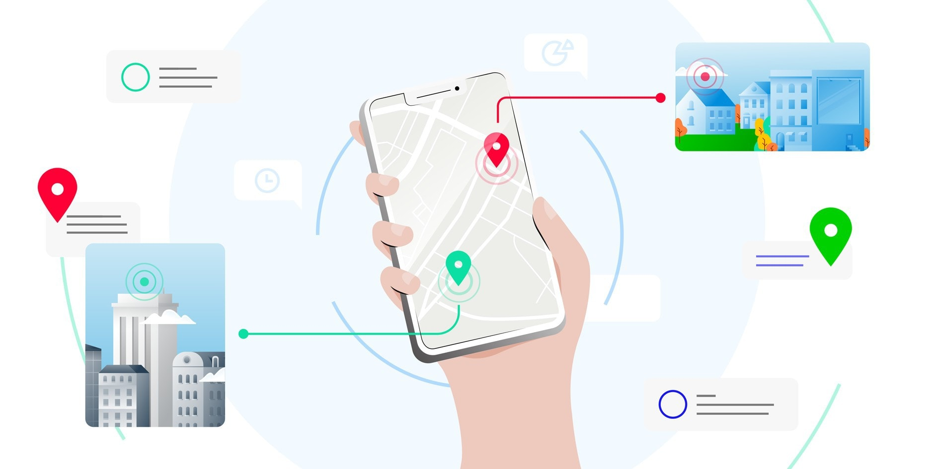
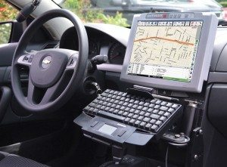
WOW Factor !!
Detects Scream
Tracked by Relatives
Tracked by police personnel’s
Provides Exact location of every victims
And shortest path to reach to the victim
Gives all the details of the users
Women can freely travel at nights also

Slide 7

Future Work
Will create separate interface for police
Will optimize the UI of the app
Will provide message alert feature
Will provide techniques for self defense
Push notification features
Try to make background system more powerful
Work on the efficiency of the app

Slide 8
Thank You

